Slide 1
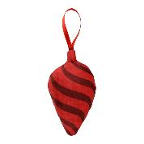
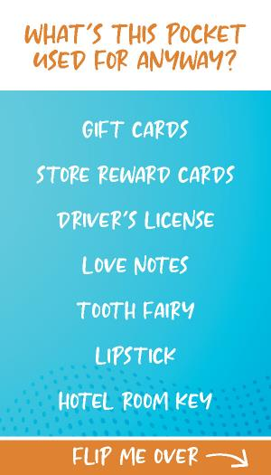
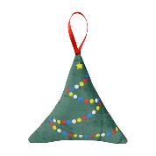
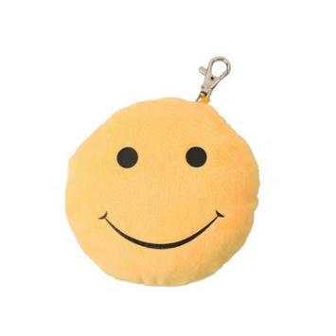
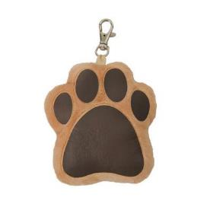
Gift Card Holder Key Chain Plush
VPLS018
Holiday plush ornaments with pockets make gift card giving easy!

Slide 2
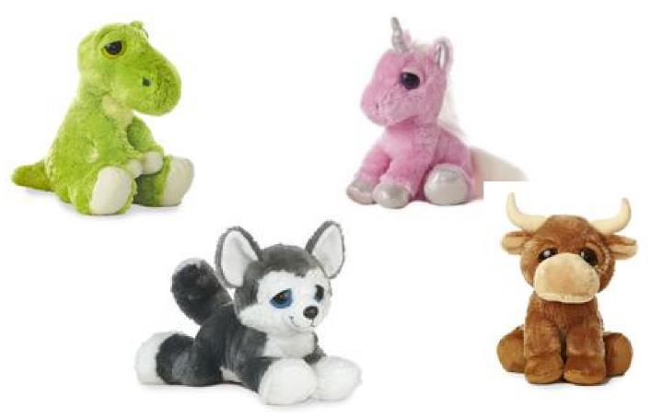
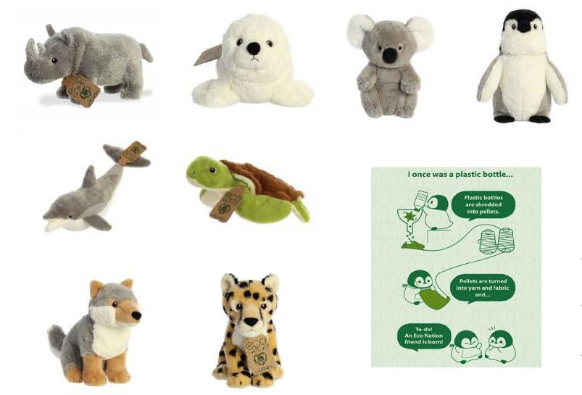
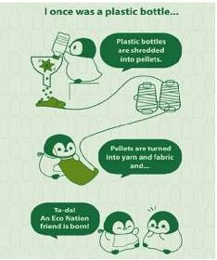
NEW NEW NEW
Dreamy Eyes – T-Rex, Pink Unicorn, Blue Eyed Wolf, Ranger The Bull We're expanding our Dreamy Eyes family to include 4 new, fun characters! Aurora's Dreamy Eyes collection features lovable sleepy expressions.
Each animal comes with an eco nation tag made from 100% recycled materials
Eco Nation Plush- Rhino, Seal, Sea turtle, Penguin, Wolf, Cheetah Eco Nation is a sustainable plush line from Aurora made from 100% recycled materials. Each animal has sweet embroidered eyes and will include a t-shirt or bandana.
includes
medium t-shirt or bandanna!

