Slide 1
Premier Group REFUEL
10/12/21
10 Reasons to Partner With Us

Slide 2
gemline Team
JAMIE GIORGI STRATEGIC ACCOUNT MANAGER
DESHAUN DIGGS VP OF STRATEGIC ACCOUNTS
Email: ddiggs@gemline.com Phone: (978) 621-6306
Email: jgiorgi@gemline.com Phone: 978-273-4184

Slide 3
TRUST
1
We have a 63-year history of providing businesses and institutions with trend-right products, and a long-standing reputation for providing the highest levels of quality, service and reliability.
Notes:
We have a 63-year history of providing businesses and institutions with trend-right products, and a long-standing reputation for providing the highest levels of quality, service and reliability.

Slide 4
2
PRODUCTS & In-house design
We offer a wide range of relevant products, many designed in-house by our own industrial design team who uncovers cultural and design trends to create sought-after products sold under multiple house brand names. We also partner with trusted retail brands to enhance our product offering.
Notes:
We offer a wide range of relevant products, designed in-house or offered through partnerships with trusted retail brands, across a breadth of price points.

Slide 5
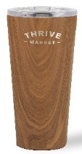
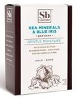
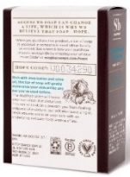
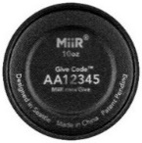
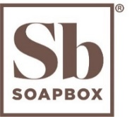
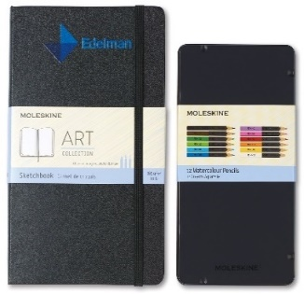
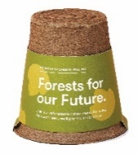
3
BRANDS THAT GIVE BACK
We partner with a variety of brands that give back profits to support charitable efforts.
Every MiiR® product sold helps fund trackable giving projects to support clean water, a healthy environment and strong communities.
Every CORKCICLE® purchase helps bring clean water to people in need through CORKCICLE’S partnership with charity : water
For every product sold, Soapbox® gives back by donating soap bars or contributing to health and hygiene initiatives in communities, both domestically and abroad.
Modern Sprout is committed to giving back - from donating a percentage of proceeds to the Pollinator Partnership for ecosystem protection, to partnering with the Heartland Alliance to provide employment for Chicago’s most vulnerable residents.
Every notebook purchased from the Moleskine Art Collection helps fund quality education experiences for marginalized youth to develop creative and change-making skills.
Notes:
We have partnered with a variety of brands that give back profits to support charitable efforts.

Slide 6
4
CORPORATE SOCIAL RESPONSIBILITY
Gemline’s Corporate Social Responsibility (CSR) efforts are focused on making a positive impact on society through environmental stewardship, ethical business practices, charitable giving, and diversity, equity & inclusion leadership.
2020 HIGHLIGHTS
ENVIRONMENTAL STEWARDSHIP
ETHICAL BUSINESS PRACTICES
CHARITABLE GIVING
DIVERSITY, EQUITY AND INCLUSION
0% Waste to Landfill from Gemline’s Lawrence, MA facility
100% of our Tier 1 suppliers have completed a social accountability audit
Formal DEI statement created and published, and internal committees formed
$500K+ donated to community organizations
*Read the full 2020 CSR report at https://gemline.com/s/corporate-social-responsibility
Notes:
Gemline’s Corporate Social Responsibility (CSR) efforts are focused on making a positive impact on society through environmental stewardship, ethical business practices, charitable giving, and diversity, equity & inclusion leadership.

Slide 7
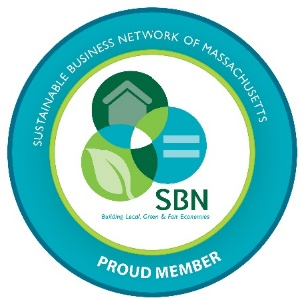
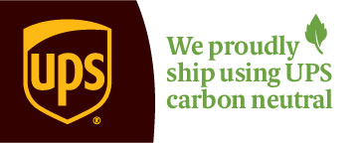
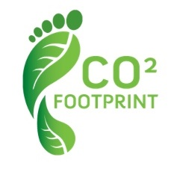
4
Environmental stewardship
2021 Accomplishments and FOCUS
Joining a movement to build a sustainable future
Gemline became a certified member of the Massachusetts Sustainable Business Leader Program
﻿Shipping with less impact
Gemline joined the UPS Carbon Neutral Program, designed to offset the CO₂ associated with our UPS shipments and to help support environmental projects.
Expanding our sustainable product offerings
Throughout 2021, we have and will continue to launch new products that meet our sustainability standards.
﻿Reducing our carbon footprint by investing in renewable energy
We recently received approval to install solar panels at our headquarters in Lawrence, MA.
Notes:
Reduce our carbon footprint by investing in renewable energy
We are actively working on plans to install solar panels at our headquarters in Lawrence, MA
﻿Ship with less impact
Gemline joined the UPS Carbon Neutral Program, designed to offset the CO₂ associated with our UPS shipments and to help support environmental projects.
Expand our eco–friendly product offering
Throughout 2021, we have and will continue to launch new products that meet our eco-friendly standards.
﻿Join a movement to build a sustainable future
Gemline became a certified member of the Sustainable Business Leader Program through the Sustainable Business Leadership Network of Massachusetts.

Slide 8
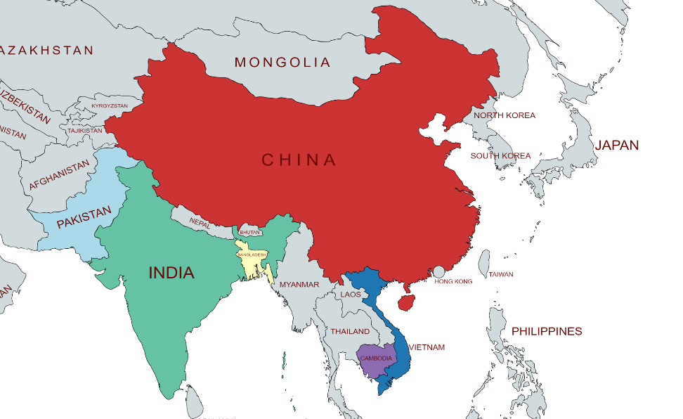
Supply chain EXPERTISE
5
Our domestic and overseas supply chain teams and our Global Solutions team ensure we source from the highest-quality manufacturers, meet 100% of industry and government compliance requirements, and deliver product in the fastest, most economical manner.
Additionally, because we receive greater than 90% of our inventory into New York, we avoid shipping delays typically seen from using West Coast and Southeast ports.
Current Supply Base: Facilities in 7 countries
Gemline has approximately 50 employees on the ground in Asia
Notes:
Our domestic and overseas supply chain teams ensure we source from the highest-quality manufacturers, meet 100% of industry and government compliance requirements and deliver product in the fastest, most economical manner.
- Current Supply Base: 41 manufacturing facilities in 7 countries
- Gemline has almost 50 employees on the ground in Asia.

Slide 9
6
INVENTORY depth
We’ve made and will continue to make commitments to hold deep product inventory of both Gemline brands and our global retail brands in our Lawrence, MA facility.
+20.1%
Notes:
We’ve made and will continue to make commitments to hold deep inventory in our Lawrence, MA facility of both Gemline brands and our global retail brands.

Slide 10
7
OPERATIONAL EXCELLENCE
SHORT & QUICK LEAD TIMES
FAST TRACK SERVICE
DROP SHIPPING
FULFILLMENT AND KITTING
WIDE VARIETY OF DECORATION METHODS
QUALITY ASSURANCE & COMPLIANCE
PROMO STANDARDS
DIRECT IMPORT

Slide 11
8
FULFILLMENT & KITTING
We offer complete fulfillment services to allow you to kit Gemline products together, or kit them with customer supplied items.
Bulk or Drop-Shipments available
Quotes provided within 48 Hours
Notes:
We offer complete fulfillment services to allow you to kit Gemline products together, or kit them with customer supplied items.
Bulk or Drop-Ship Available
Quotes provided in 48 Hours

Slide 12
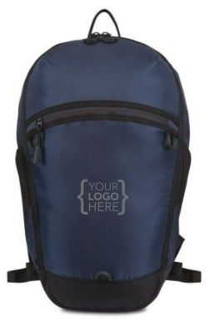
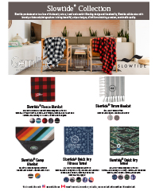
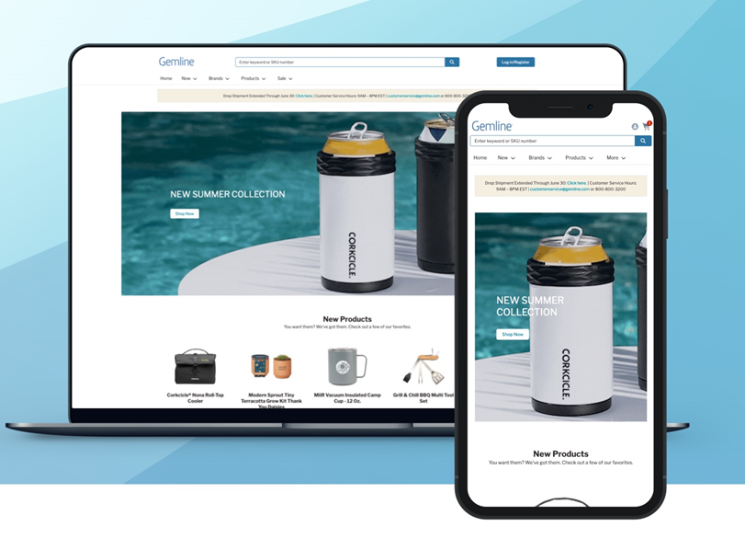
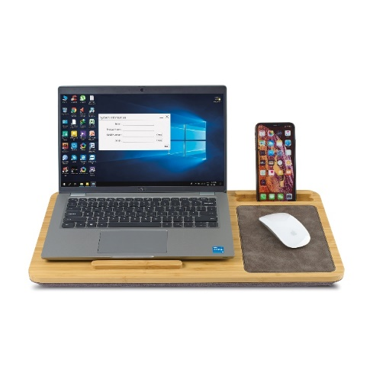
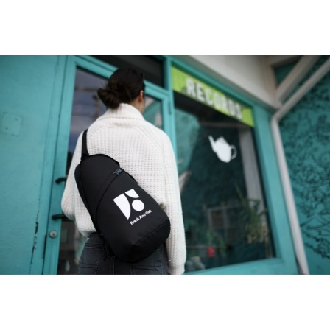
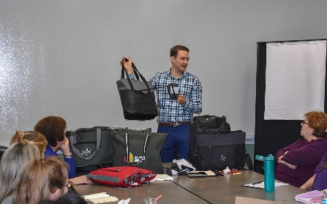
9
TOOLS TO HELP YOU SELL
Gemline offers a variety of selling tools, many available 24/7/365 on gemline.com*
PRE-SALE VIRTUALS*
FLYERS*
E-CATALOGS*
WEBSITE*
PRODUCT IMAGES*
LIFESTYLE IMAGES*
PRODUCT VIDEOS*
IN-PERSON PRESENTATIONS
Notes:
Gemline offers a variety of selling tools, many available 24/7/365 on gemline.com*

Slide 13
10
Exceptional customer Experience
Our promise is to provide an exceptional customer experience every time you interact with us.
We’ve even increased our workforce by 15% over 2019 levels so that we can continue to provide YOU with our highest level of service.
We deliver on-trend, on-time and on-budget.
99%
On-Time Product Delivery
99%
Customer Quality Rating
98%
Questions Answered on First Call
23 seconds
Average Speed to Answer Call
Notes:
Our promise is to provide an exceptional customer experience every time you interact with us.
We’ve even increased our workforce by 15% so that we can continue to provide YOU with our highest level of service.

Slide 14
Thank You

