Slide 1


2021 Holiday
Trends
mkory@hitpromo.net
470-455-8720

Slide 2
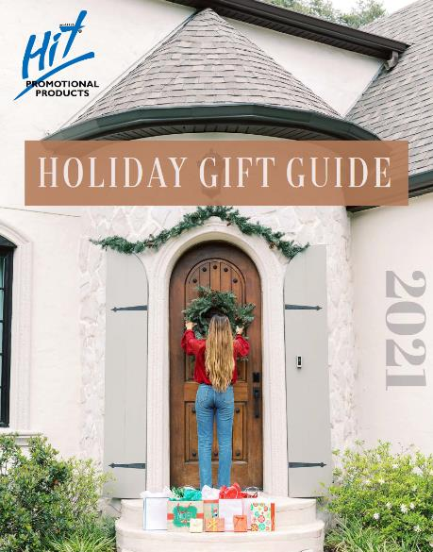
Holiday Gift Guide Now Available!
Branded Version:
https://viewer.zoomcatalog.com/hit-promo-holiday-2021
Customizable Version:
https://custom.zoomcatalog.com/add/catalog-cover?parent=1380847

Slide 3
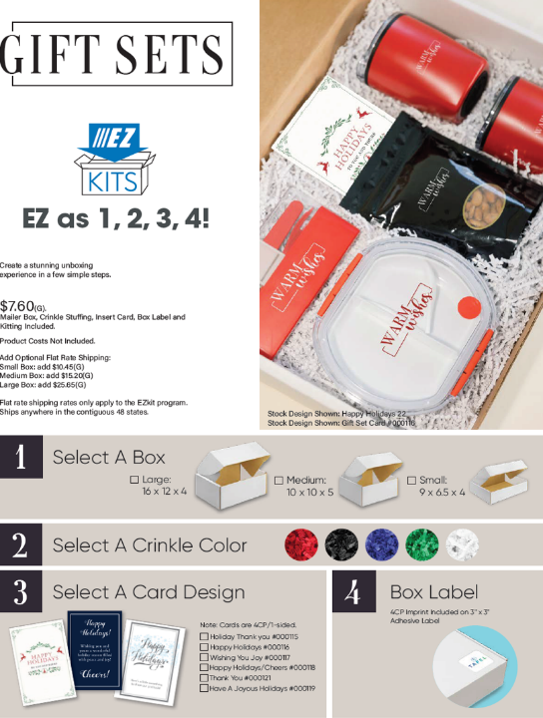
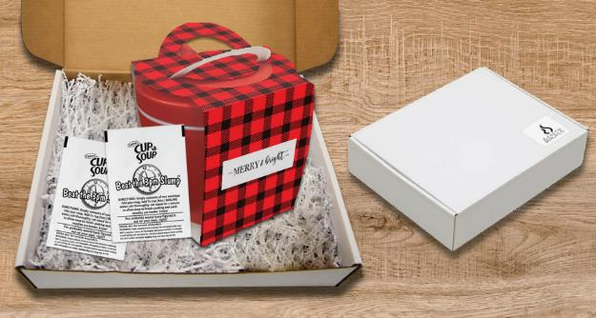
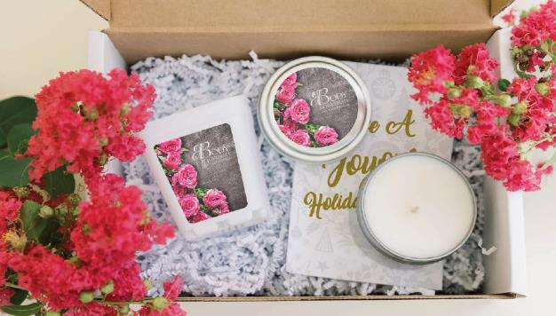
Notes:
With hybrid-working and slow returns to the office, drop shipping is still key.
EZ kits are a great way to send holiday gifts.
Boxes are shippable and don’t require any additional drop ship charges.

Slide 4
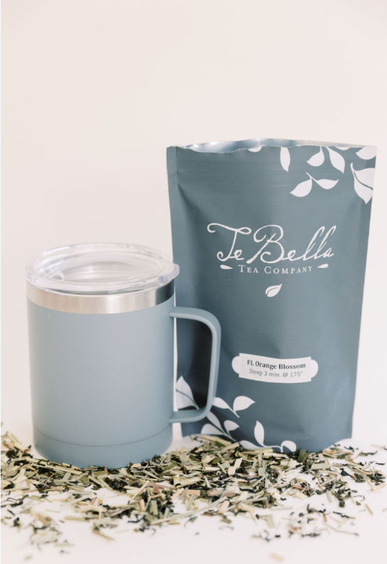
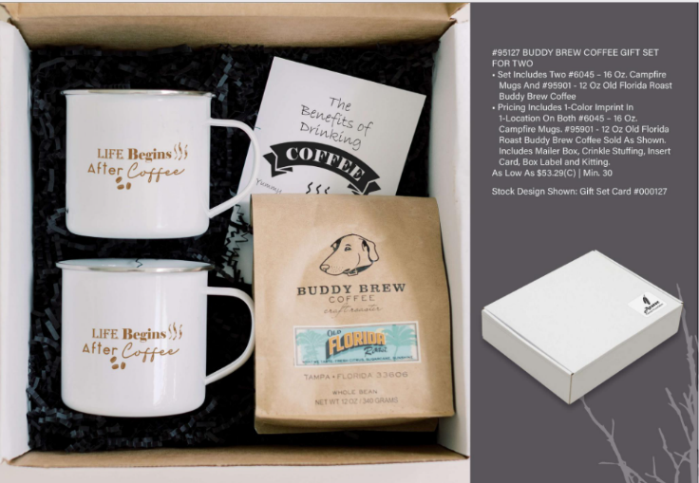


Tea & Coffee
Gift Sets
Notes:
One of our most popular gift sets are the Te Bella or Buddy Brew Coffee sets for 1, 2, or 4

Slide 5
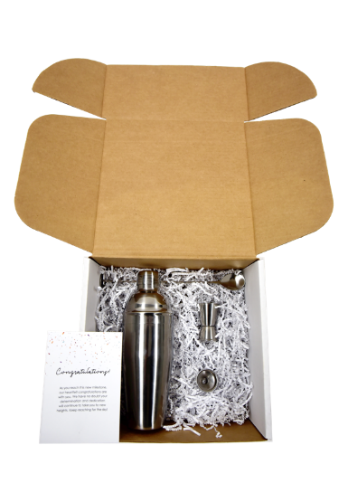
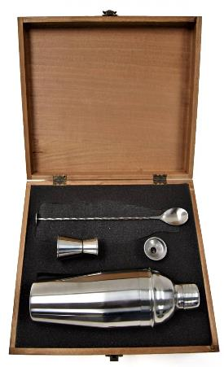
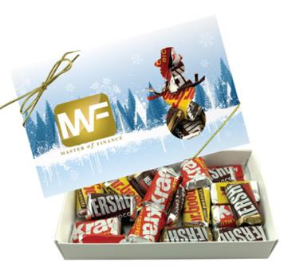

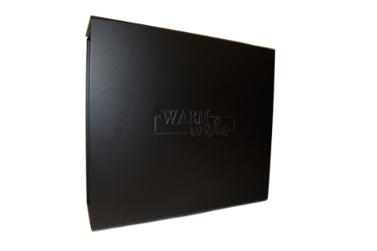
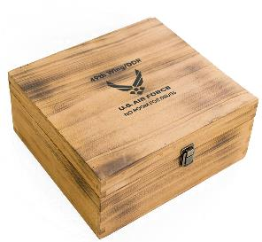

Gift Box Options
“The Unboxing Experience”
1
#95156 Shaker Gift Set in Mailable Box
RECBOX – Snowman Custom Candy Box
Debossed Gift Box
4. 0BOXWOOD Wooden Gift box
4
3
Notes:
No matter what kind of gift box you are looking for, Hit has solutions at different price points.

Slide 6
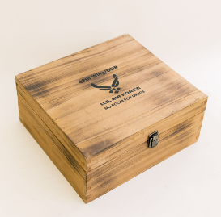
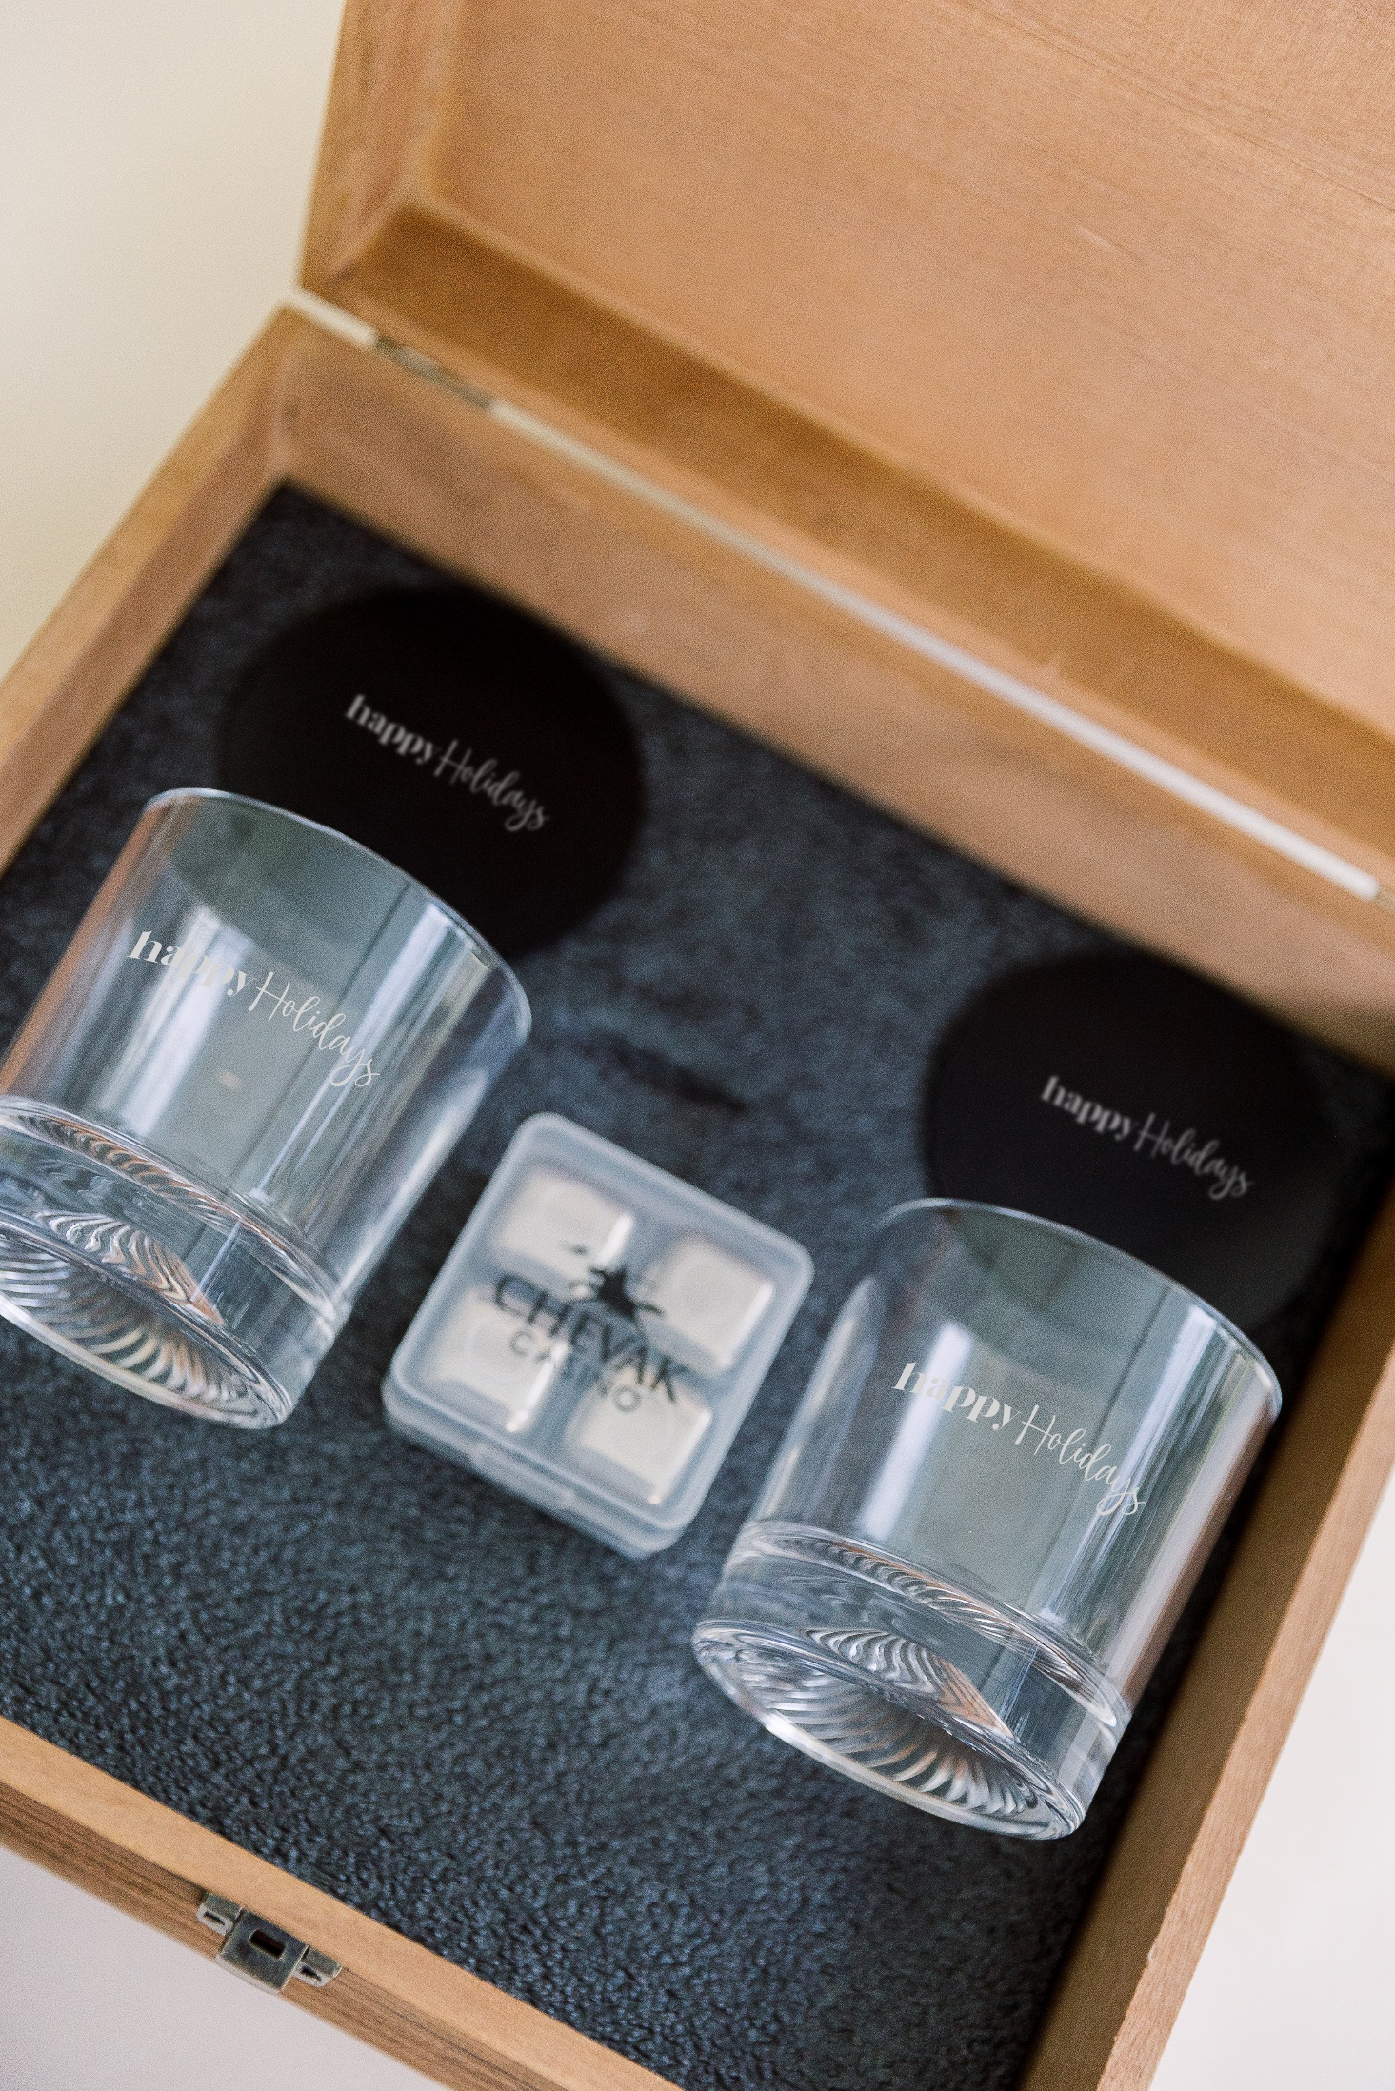
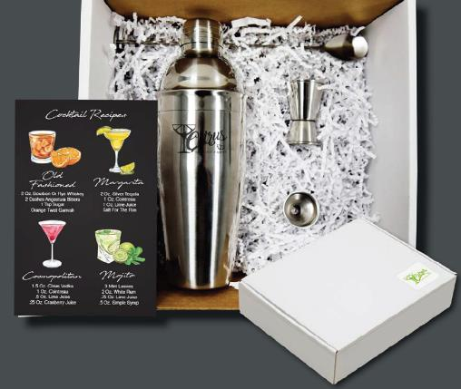
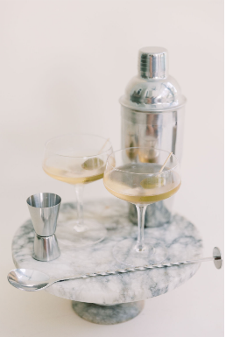
Popular Gift Sets
#95156 Shaker Gift Set
2. #95159 Whiskey Gift Set
1
Notes:
Popular gift sets

Slide 7
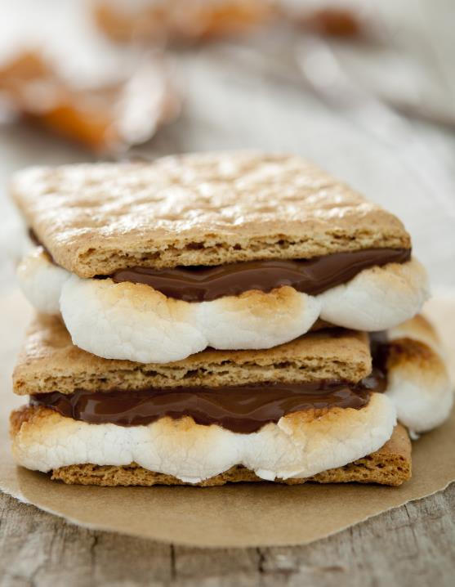
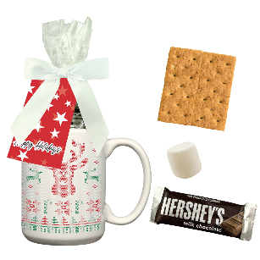
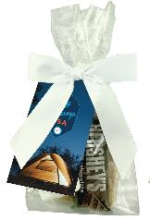
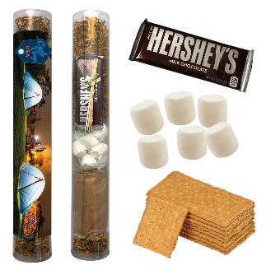
Smores Kits
1
2
#95163 Smores Stuffer
#95177 Smores Stuffer Kit in Ceramic Mug
#95182 Smores Kit in Tube Packaging
3
Notes:
These kits will be completed and inventoried in New Jersey.
Smores are trending and are one of the biggest asks over the fall and winter holidays.

Slide 8

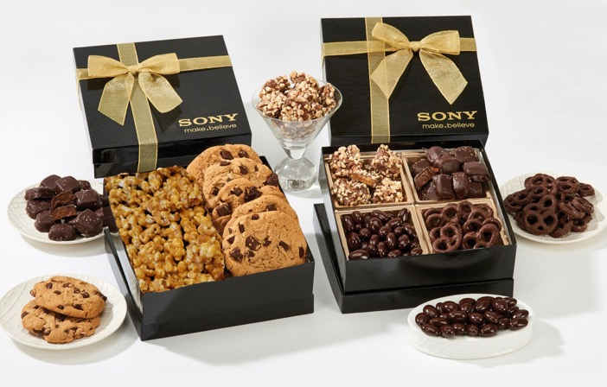
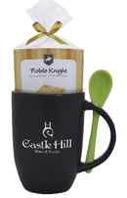
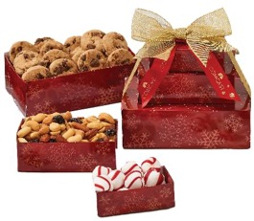
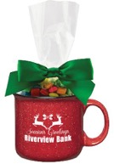
#GB4
#TT3
Retail Inspiration
#9844
#9849
#989
Notes:
Hit continues to enjoy tremendous success with food gifts over the holiday season.
We often pair food gifts with traditional hard goods, ensuring lasting impressions

Slide 9

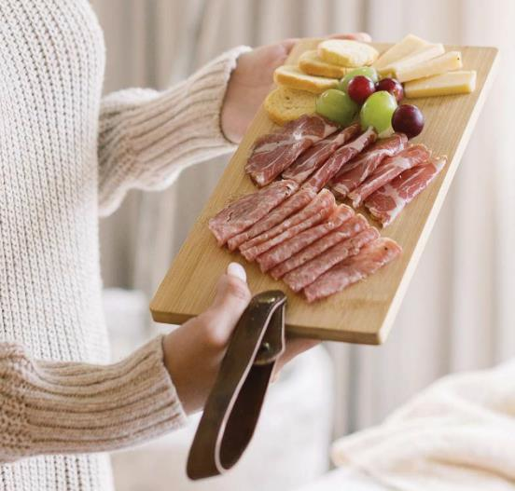

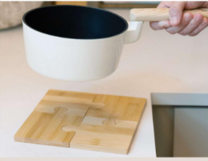
1. #76133 – US Map Bamboo Cutting Board
2. #76137 – Cutting Board w/ Leatherette Strap
3. #2254 Bamboozle Puzzle Coaster Set
1
2
3
Notes:
Marketers continue to target people in their homes.
Cutting boards and coasters are a great way to stay top of mind.
Meat and cheese boards were one of the top sellers for holiday 2020.

Slide 10
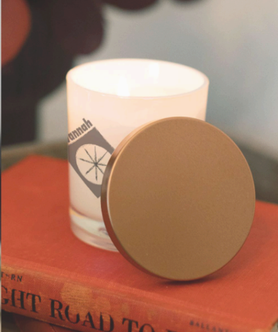
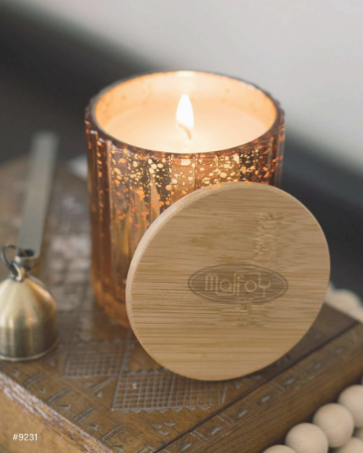

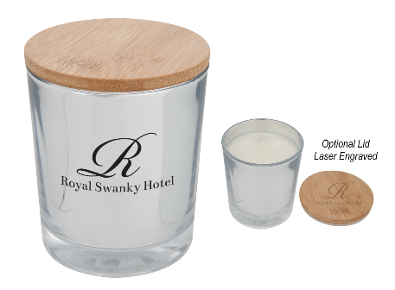
2
1. #9231 Aria Candle
#9232 Atlas Candle
#9230 Bamboo Soy Candle
3
Notes:
Candles have become one of the top trending items during holiday. We’ve added several new styles and colors.

Slide 11
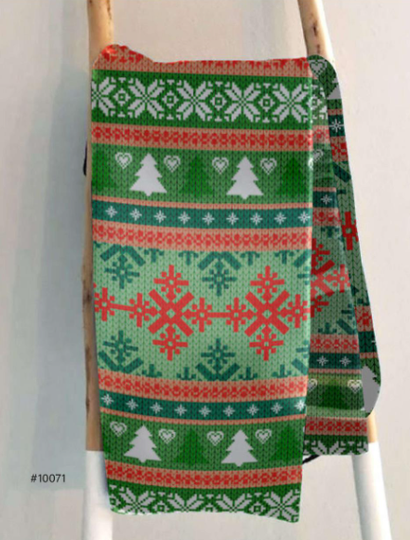
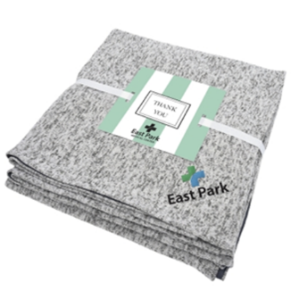
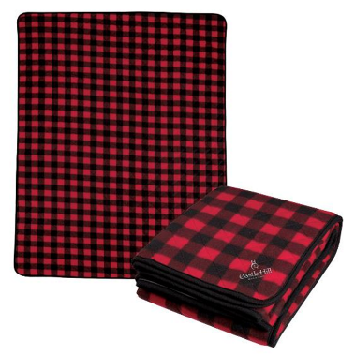
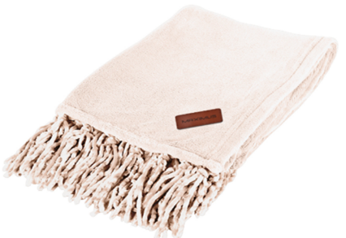
#10071 50’ x 50’ Faux Mink Suede Blanket
#8010 Heathered Fleece Blanket
#8028 Chateau Chenille Fringed Blanket
#7001 Northwoods Blanket
2
1
4
3
Notes:
I’m sure everyone remembers that blankets were hard to find last year.
Hit has made a commitment to increase inventory in 2021 including adding to the styles we offer.
Ugly Christmas blankets are hot. Make sure to allow 30 days production on these custom items.

Slide 12
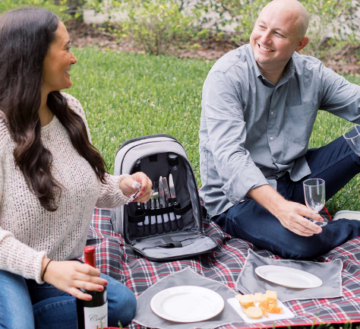
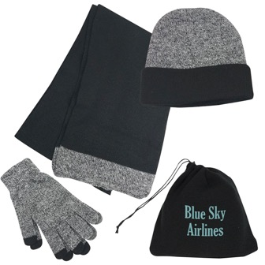
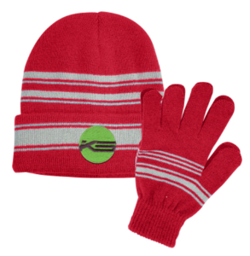
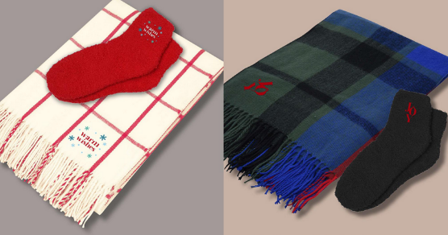
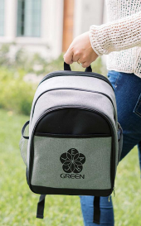
#1144 Cold Weather Set
#35014 – Picnic Set For 2 with Cooler Backpack
#1143 Cuff Beanie And Gloves Set
#95179 & #95180 Kitted Blankets and Fuzzy Socks
1
2
3
4
Notes:
Hit sells a ton of beanies and scarves during the holiday season.
We’ve added several retail inspired options for 2021

Slide 13

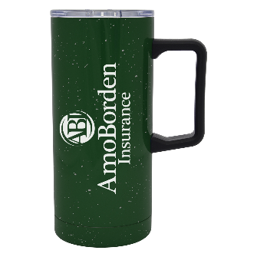
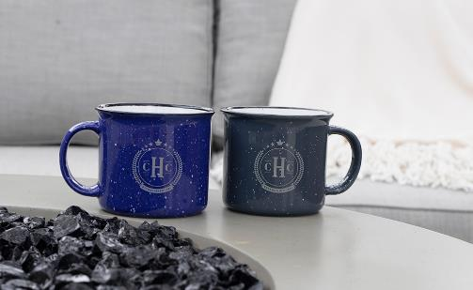
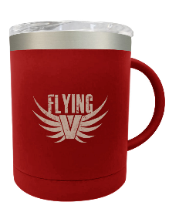
1
#8165 – 15 Oz. Campfire Bamboo Mug
#5537 – 17 Oz. Speckeled Stainless Steel Travel Tumbler
#50108 - 12 Oz. Stainless Steel Mug
#7133 – 15 Oz. Campfire Mug
Retail Inspiration
4
2
3
Notes:
Campfire mugs continue to exceed expectations.
Whenever we have success with an item, you will see variations on that theme in lots of styles and colors.

Slide 14
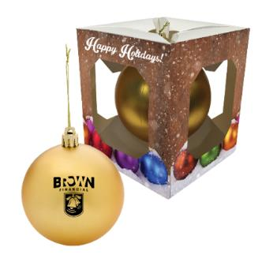
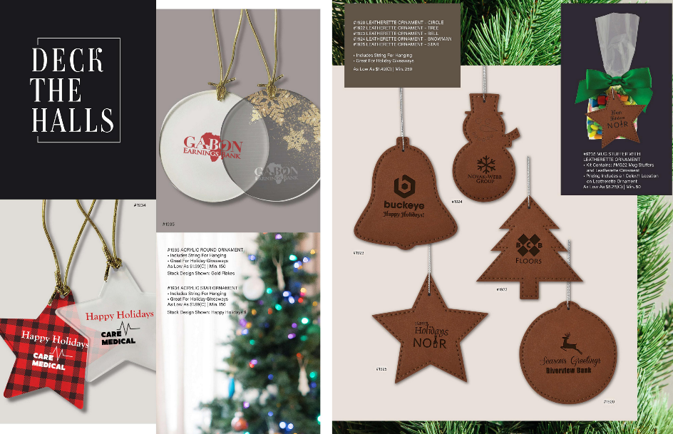
#1935 Clear Circle Acrylic Ornament
#1934 Clear Star Acrylic Ornament
Leather or Wood Ornaments
4. #1225 & #1225P Round Ornament with Custom Window Box
Also Available in Wood
Retail Inspiration
Notes:
Looking for inexpensive holiday gifts?
Ornaments are a great way to buy impressions at a reasonable price point.

Slide 15
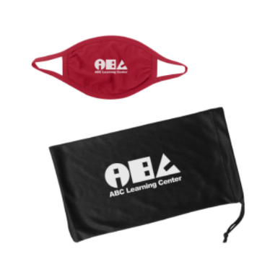

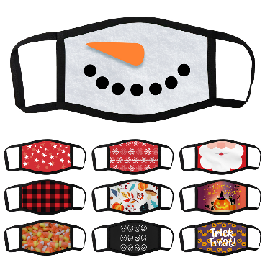


Dye Sublimated Holiday Masks
1
3
2
Retail Inspiration
#99111 Dye Sublimated 3-Layer Mask
#95083 Dye Sublimated 3-Layer Mask & Pouch
#95085 Youth 2-Ply Cotton Mask & Mask Pouch
Retail Inspiration
Notes:
Unfortunately, mask sales are back on the rise. Let’s make masks more fun.
We’ve designed a bunch of cool looks and different patterns, or you can design your own.

Slide 16
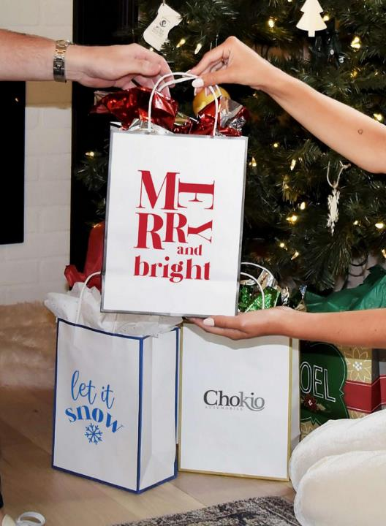
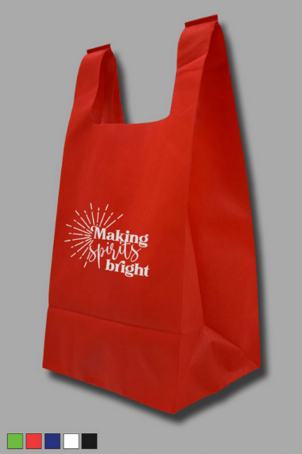
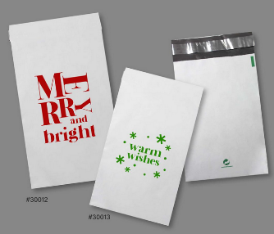

Holiday Packaging
Use Reusable Options
Create Your Own Custom Bags
1
3
#3921 Laminated Paper Bag
#30012 & #30013 Biodegrade Shipping Bag
#30038 Reusable Non-Woven Bag
2
Notes:
When selling holiday gifts, don’t forget about the packaging.
This is a great way to increase sales. It’s as simple as “do you want fries with that…”

Slide 17
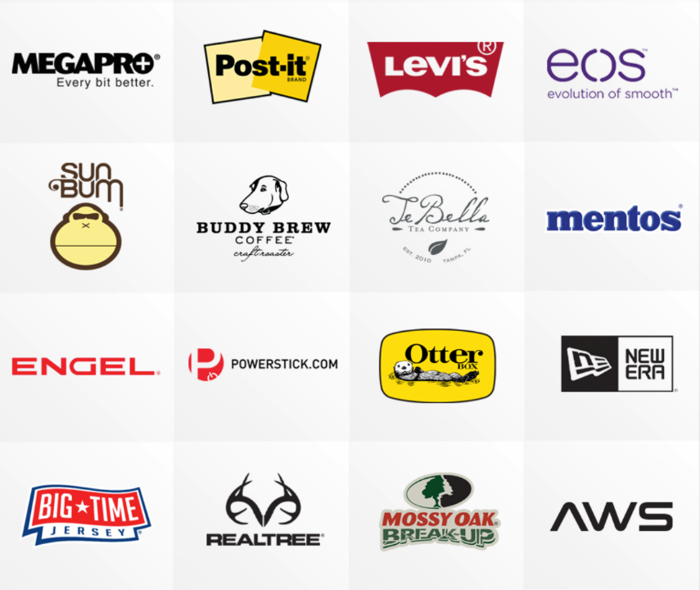
A WIDE SELECTION OF BRANDS
We offer a large collection of brands to fit any promotional campaign need.

Slide 18

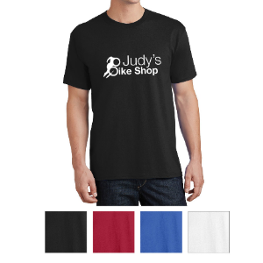
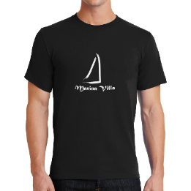
Your One Stop Apparel Solution
#PC54 Port & Company® Core Cotton T-Shirt
As Low As $4.29c
#PC61 Port & Company® Essential T-Shirt
As Low As $5.39c
Notes:
17 styles currently on the FSM program.
96 piece minimums

Slide 19



Slide 20






NEW COLLECTION: 100% RECYCLED PET
#30003 Non-Woven Tote Bag With 100% RPET
2. #30001 Non-Woven Shopper Tote
Bag With 100% RPET
#7857 Recycled PET Cooling Sport Towel
#30000 Non-Woven Budget Tote Bag With 100% RPET
1
4
2
3

Slide 21




#DM130 District® Men's Perfect Tri™ Crew Tee

Slide 22




#3884 PLA Non-Woven Tote Bag
2. #3886 PLA Non-Woven Shopper Tote Bag
#3885 PLA Non-Woven Drawstring Bag
1
2
3
PLA Polylactic Acid
Non-Woven Material
Renewable Vegetable-based resource
from Plant Material

Slide 23








Quick Turn Items
Shipping from NJ factory
MINT TINS
Multiple varieties available!
#GP01
12-Pc BILLBOARD GUM PACK
#POP01
Microwave Popcorn Flat
ZAGASNACKS
Available in multiple sizes and fill options!
DOG TREATS
Dog bones available in a variety of container options.
Notes:
Hit NJ is able to handle rush orders.
NJ has stock in several different food and candy options

Slide 24


Notes:
Hand sanitizers in various shapes and sizes also ship out of NJ

Slide 25




Quick Turn Items
Shipping from NJ factory
#LB0
USA Made Lip Moisturizer
#EOS-LIPB
Eos Smooth Sphere Lip Moisturizer
#SLT06
Lip Moisturizer Slider Tin
Dress it up with a Zagabook!
Notes:
We make our own beeswax lip balms and carry the EOS and Mentos brands as well.

Slide 26


Notes:
First and foremost, we are Importers!
Our overseas team is great at creating and sourcing custom projects
We have incredible buying power and relationships with overseas vendors

Slide 27







Themes
UPCOMING NATIONAL HOLIDAYS & EVENTS
Notes:
The themes tab makes it easy to generate ideas for upcoming campaigns.
We frequently add new theme ideas to help with any projects.

Slide 28









Lifestyle Library
Notes:
Our lifestyle library is there for your use. It’s all about content, and we have images and videos for you to upload to your social media.
Our images are not watermarked and don’t have Hit logos, making them very user friendly.
Follow us on Social Media

Slide 29
THANK YOU

